Slide 1

Should We Upgrade Our Claim Severity Model
Presented by Helen Corbat M.S. Data Science — University of Virginia B.S. Chemical Engineering — Purdue University
A Data-Driven Evaluation of Model Performance and Uncertainty
Notes:
“Hi, I’m Helen. In this project, I evaluate whether we should replace our current claim severity model with a new machine learning model.
I focus not only on whether the new model performs better, but also on how confident we are in that improvement.
The goal is to make a clear, data-driven recommendation on whether the new model should be adopted.”

Slide 2

Business Problem – Claim Severity Model Upgrade
Northbrook Mutual currently uses Model A (regularized linear regression) to predict claim costs
A new model, Model B (gradient boosting), is proposed as a replacement
Accurate claim cost prediction is critical for pricing and profitability
Notes:
“Right now, Northbrook Mutual is using Model A, a linear regression model, to predict claim costs.
There’s a proposed replacement, Model B, which is a gradient boosting model.
Because these predictions directly affect pricing and profitability, it’s important to know whether the new model truly performs better.
So the goal here is to evaluate whether Model B provides enough improvement to justify an upgrade.”

Slide 3
Evaluation Framework
Evaluation Scope
Personal Auto (~12,000 claims)
Commercial Property (~4,500 claims)
Performance Metric
Mean Absolute Error (MAE)
Decision Criteria
Improvement must be:
Meaningful in magnitude
Reliable (low uncertainty)
Notes:
“To evaluate the models, I followed a structured framework.
I analyzed both personal auto and commercial property claims, using MAE as the performance metric.
And the decision ultimately depends on whether the improvement is both meaningful and reliable.”
“To evaluate the models, I followed a structured framework.
I looked at two product lines: personal auto and commercial property claims.
I used Mean Absolute Error as the performance metric to measure prediction accuracy.
And most importantly, the decision is based on whether the improvement is both meaningful in size and reliable, meaning we’re confident it’s not just noise.”
“MAE provides a balanced view of prediction accuracy without being overly influenced by rare, extreme claims”
🧠 One deeper insight (this is next-level understanding)
MAE → aligns with median-type behavior
MSE → aligns with mean-type behavior
Since claim data is skewed: 👉 MAE is often more stable and interpretable

Slide 4
Analytical Approach
1. Compare Model Performance
Compute MAE for Model A and Model B
Evaluate improvement (Model B vs Model A)
2. Quantify Improvement
Calculate difference in MAE across CV folds
Assess average performance gain
3. Assess Uncertainty
Measure variability across folds
Estimate confidence in improvement
4. Make Recommendation
Is improvement meaningful?
Is it reliable?
Recommend whether to adopt Model B
Notes:
“Next, I followed a four-step analytical approach.
First, I compared model performance by computing MAE for both models.
Second, I quantified the improvement by looking at the difference in MAE between Model B and Model A.
Third, I assessed uncertainty by examining how consistent that improvement is across cross-validation folds.
Finally, I used both the magnitude and reliability of the improvement to make a recommendation on whether Model B should be adopted.”

Slide 5
Model Performance Evaluation Using Personal Auto Claim Dataset

Slide 6
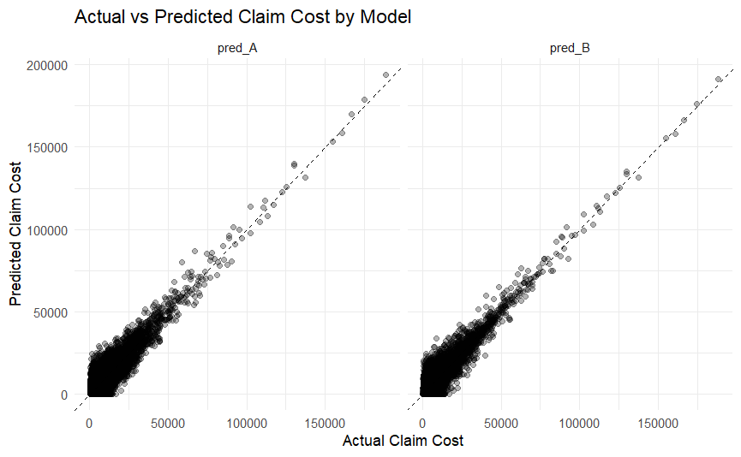
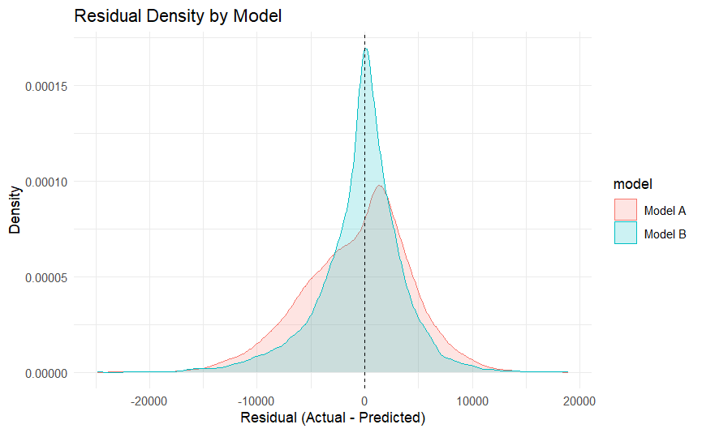
Model Behavior & Diagnostic Insights
Both models tend to underpredict higher-cost claims
Model B shows tighter alignment with actual values (lower variance)
A noticeable proportion of predictions are zero, contributing to underestimation
Notes:
“I first examined model behavior before quantifying performance.
Both models tend to underpredict higher-cost claims, but Model B shows tighter alignment with actual values and lower error variability.
The residual density confirms this pattern, with Model B’s errors more concentrated around zero.
I also observe a noticeable proportion of zero predictions, which contributes to underestimation.”

Slide 7
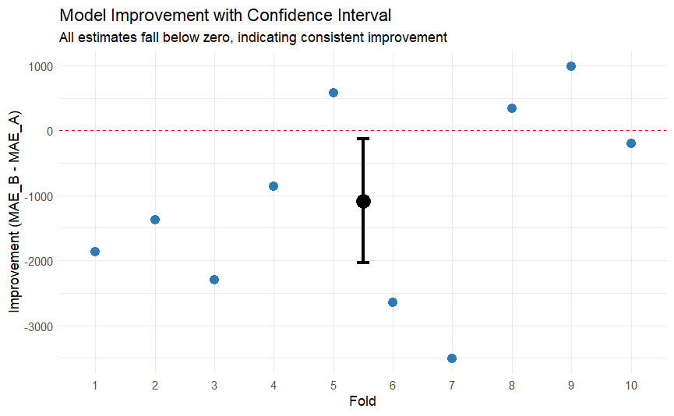
Model B Delivers Meaningful and Consistent Improvement
🔹 Key Findings
Model B reduces MAE by ~$1,085 per claim
Improvement observed in 7 out of 10 folds
Some variability exists across folds
🔹 Confidence Assessment
Confidence interval: [-$2,038, -$132]
Entire interval below zero → Improvement is statistically reliable
🔹 Business Interpretation
Even in the worst-case scenario, Model B still improves performance
Reduction in prediction error supports better pricing decisions
Notes:
For the personal auto claims dataset, Model B reduces prediction error by approximately $1,085 per claim. While some variability exists across folds, the improvement is observed in most cases (7 out of 10 folds). Importantly, the confidence interval lies entirely below zero $\left[− , 2 , 038−132\right]$, indicating that the improvement is statistically reliable. Even in the worst-case scenario, Model B still outperforms Model A, supporting a confident recommendation for adoption.

Slide 8

Model Performance Evaluation Using Commercial Property Claim Dataset

Slide 9
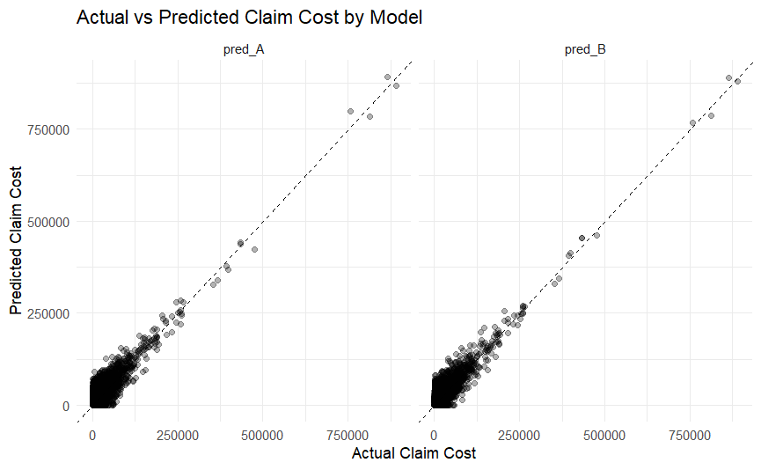
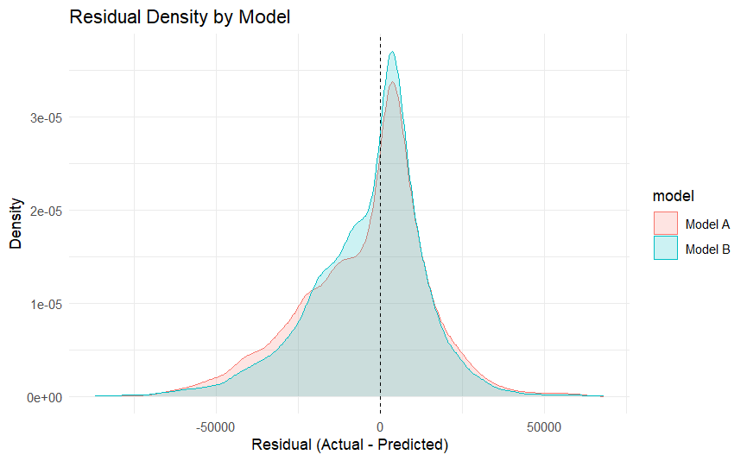
Model Behavior – Commercial Property Claims
Key Takeaways
Both models underpredict high-cost claims
Model B shows tighter fit and lower variability
Errors remain large for extreme claims (challenging dataset)
Notes:
“Both models tend to underpredict high-cost claims. Model B shows a tighter fit and more stable predictions overall. However, large claims remain difficult to predict, highlighting the challenging nature of this dataset.”
“Model B has a higher peak around zero, indicating that a larger proportion of predictions have small errors.”

Slide 10
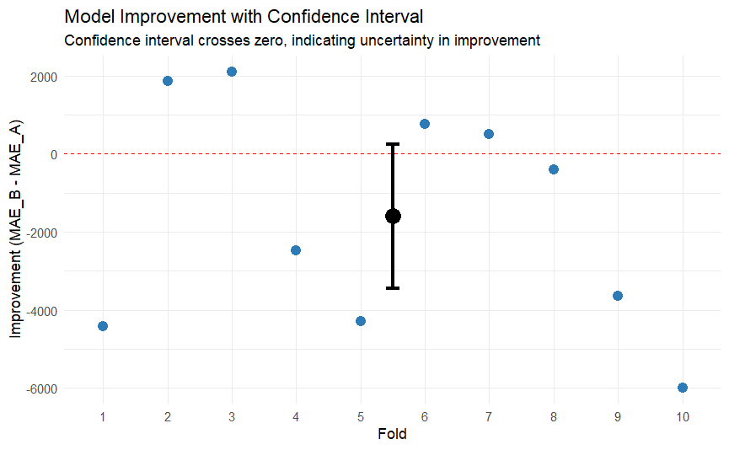
Model B Shows Improvement but with High Uncertainty
🔹 Key Findings
Model B reduces MAE by ~$1,600 per claim (on average)
Improvement observed in 6 out of 10 folds
Performance varies across folds
🔹 Confidence Assessment
Confidence interval: [-$3,442, +$244]
Interval crosses zero → Improvement is not statistically reliable
Business Interpretation
Model B can deliver large gains, but also risk of worse performance
Not enough evidence to support full replacement
Notes:
On the commercial property dataset, Model B shows a larger average reduction in error of approximately $1,600 per claim. However, performance is less consistent across folds (6 out of 10), and the confidence interval crosses zero $\left[− , 3 , 442+244\right]$, indicating that the improvement is not statistically reliable. As a result, we cannot confidently conclude that Model B consistently outperforms Model A in this setting.

Slide 11
Adopt Model B Selectively Based on Business Line
🔹 Personal Auto Claims
Recommend adopting Model B
Meaningful reduction in error
Improvement is statistically reliable
Low risk of performance degradation
🔹 Commercial Property Claims
Do not recommend full replacement
Larger average improvement, but
Improvement is not statistically reliable
Risk of worse performance remains
🔹 Final Recommendation
Deploy Model B for personal auto only Conduct further validation before adopting for commercial property
Notes:
These results indicate that model performance varies by line of business and should be evaluated separately. We recommend adopting Model B for personal auto claims, where it delivers consistent and reliable improvement. For commercial property, we recommend holding off on replacement due to uncertainty in performance.

